Slide 1
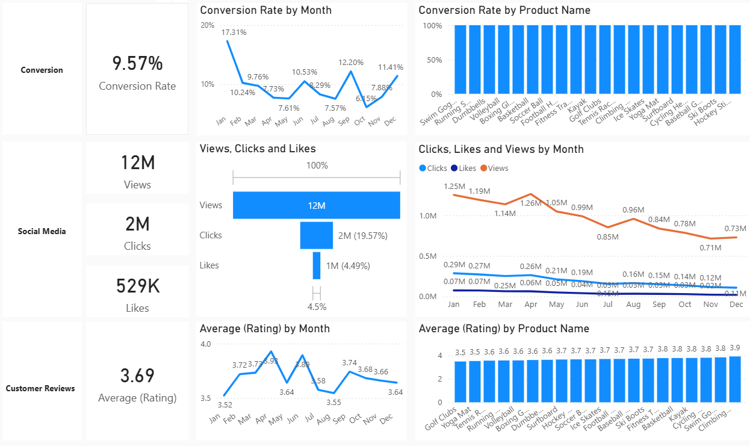
Data Presentation : Overview
Decreased Conversion Rates: The conversion rate demonstrated a strong rebound in December, reaching 11.41%, despite a notable dip to 6.15% in October.
Reduced Customer Engagement:
There is a decline in overall social media engagement, with views dropping throughout the year.
While clicks and likes are low compared to views, the click-through rate stands at 19.57%, meaning that engaged users are still interacting effectively.
Customer Feedback Analysis:
Customer ratings have remained consistent, averaging around 3.7 throughout the year.
Although stable, the average rating is below the target of 4.0, suggesting a need for focused improvements in customer satisfaction, for products below 3,5.

Slide 2
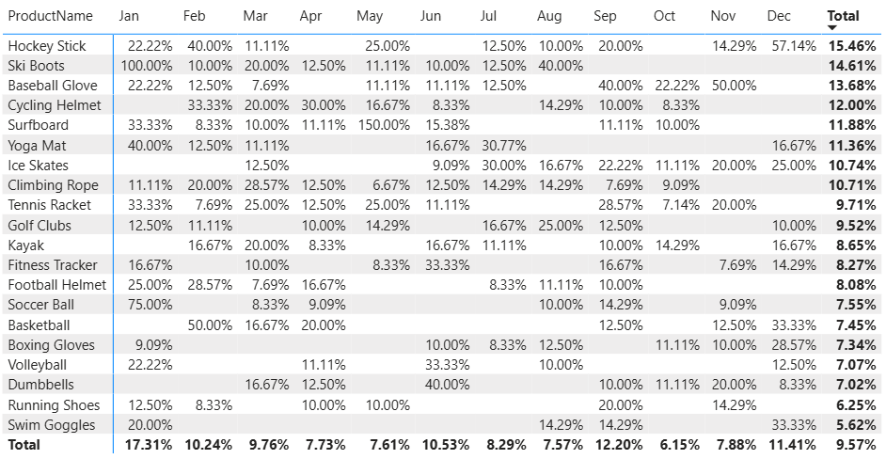
Decreased Conversion Rates
General Conversion Trend:
Throughout the year, conversion rates varied, with higher numbers of products converting successfully. This suggests that while some products had strong seasonal peaks, there is potential to improve conversions in lower-performing months through targeted interventions.
Lowest Conversion Month:
May experienced the lowest overall conversion rate at 6.15%, with no products standing out significantly in terms of conversion. This indicates a potential need to revisit marketing strategies or promotions during this period to boost performance.
Highest Conversion Rates:
January recorded the highest overall conversion rate at 17.31%, driven significantly by the Ski Boots with a remarkable 150% conversion. This indicates a strong start to the year, likely fueled by seasonal demand and effective marketing strategies.

Slide 3
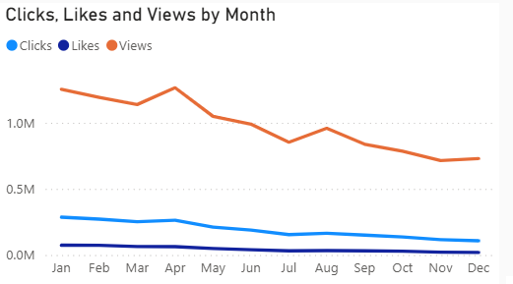
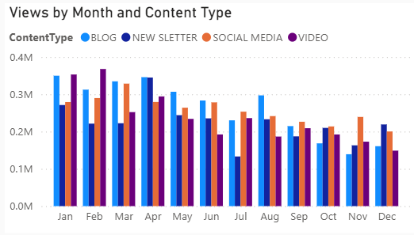
Reduced Customer Engagement
Declining Views:
Views peaked in Jan and Fab but declined from Jul and on, indicating reduced audience engagement in the later half of the year.
Low Interaction Rates:
Clicks and likes remained consistently low compared to views, suggesting the need for more engaging content or stronger calls to action.
Content Type Performance:
Video content drove the most views, especially in Nov and Dec, while social media and Blog content maintained steady but slightly lower engagement.

Slide 4
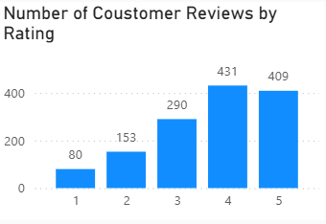
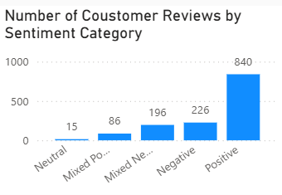
Customer Feedback Analysis
Customer Ratings Distribution:
The majority of customer reviews are in the higher ratings, with 431 reviews at 4 stars and 409 reviews at 5 stars, indicating overall positive feedback. Lower ratings (1-2 stars) account for a smaller proportion, with 80 reviews at 1 star and 153 reviews at 2 stars.
Sentiment Analysis:
Positive sentiment dominates with 840 reviews, reflecting a generally satisfied customer base. Negative sentiment is present in 226 reviews, with a smaller number of mixed and neutral sentiments, suggesting some areas for improvement but overall strong customer approval.
Opportunity for Improvement:
The presence of mixed positive and mixed negative sentiments suggests that there are opportunities to convert those mixed experiences into more clearly positive ones, potentially boosting overall ratings. Addressing the specific concerns in mixed reviews could elevate customer satisfaction.

Slide 5
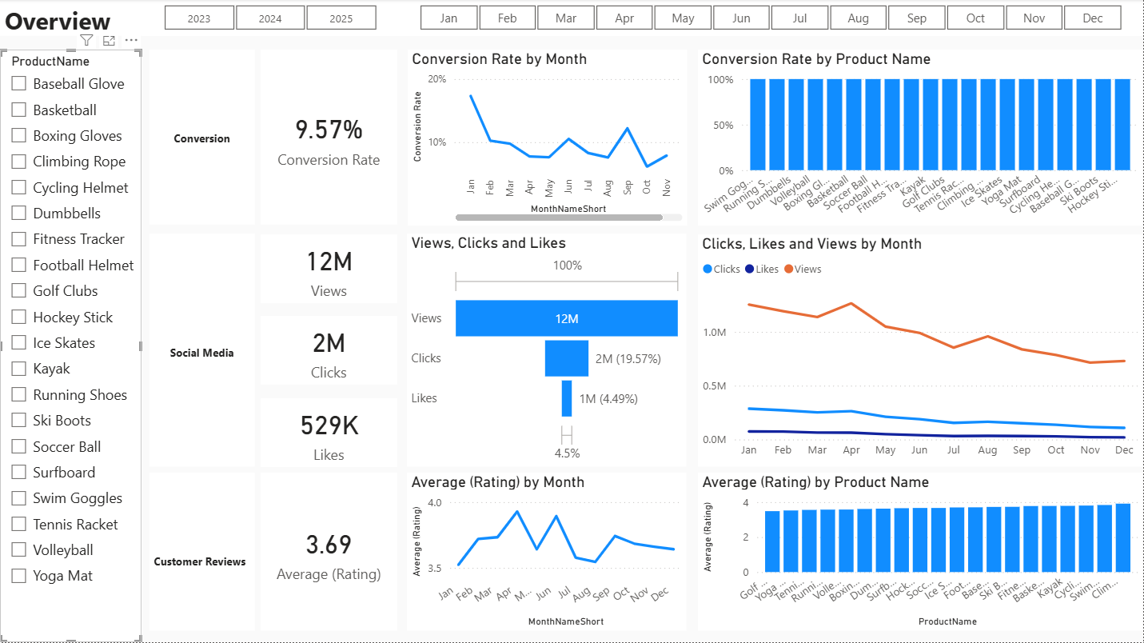
Final Screenshots of Dashboard

Slide 6
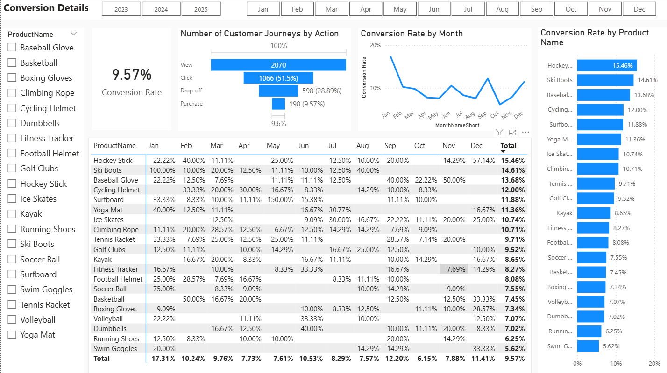

Slide 7
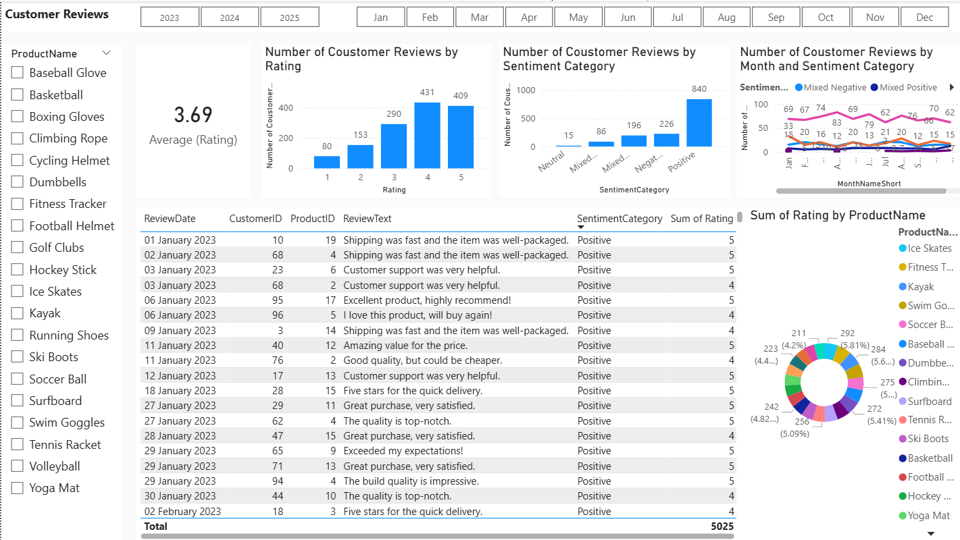

Slide 8
